Slide 1
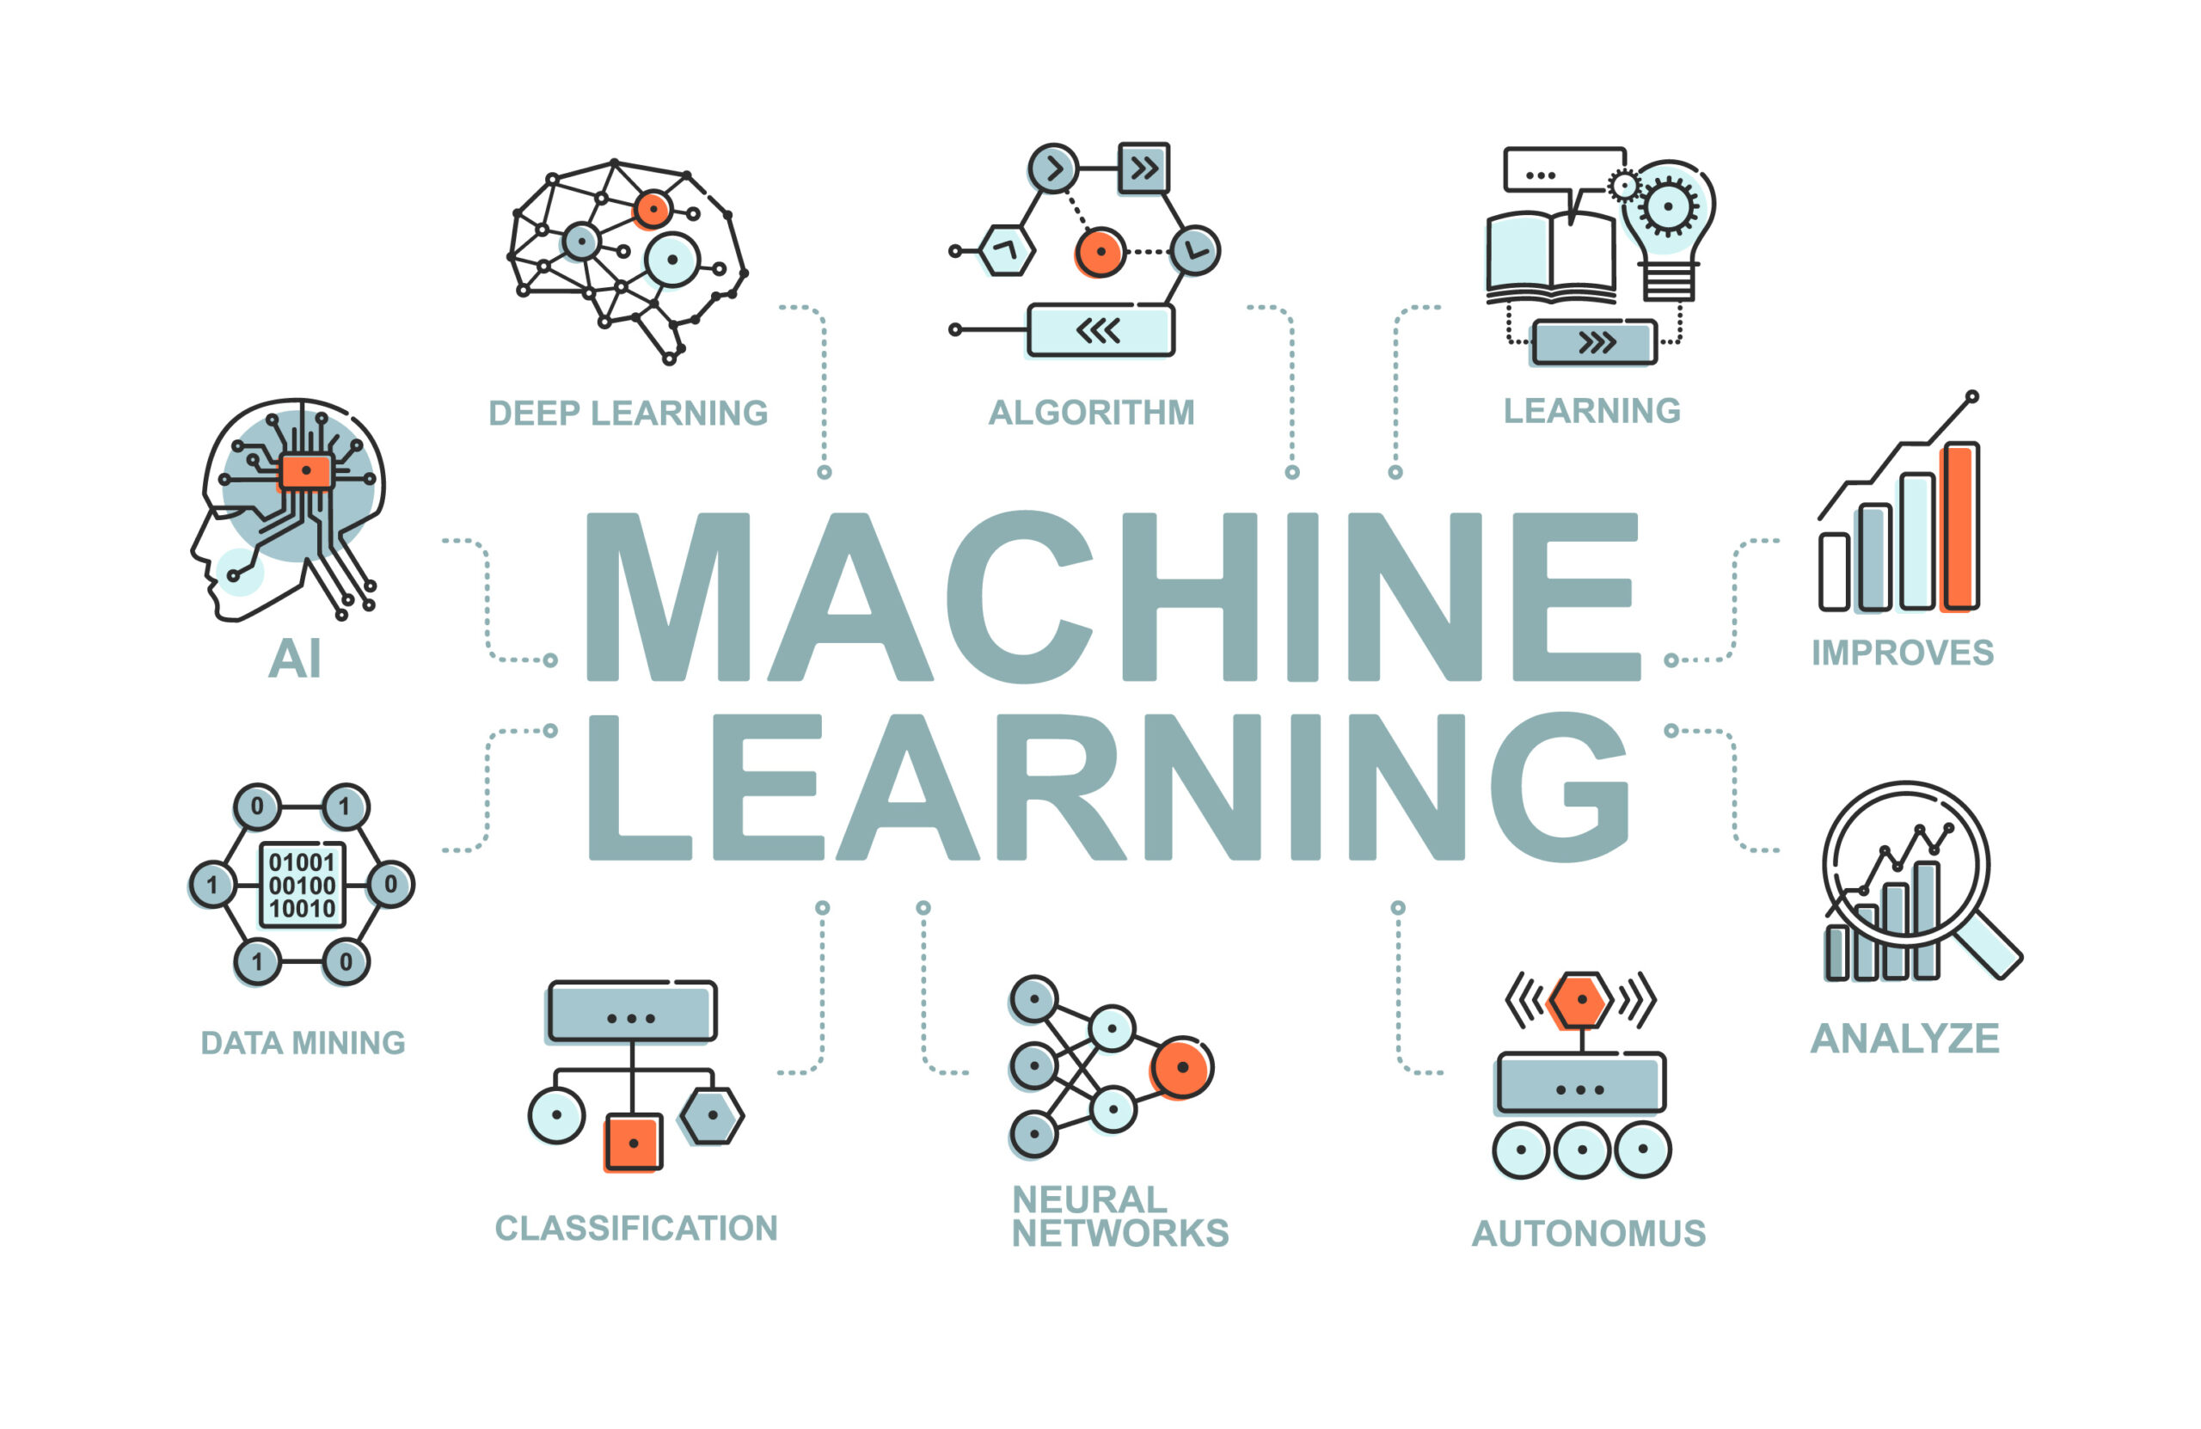
UNSUPERVISED CLUSTERING MEAN SHIFT

Slide 2
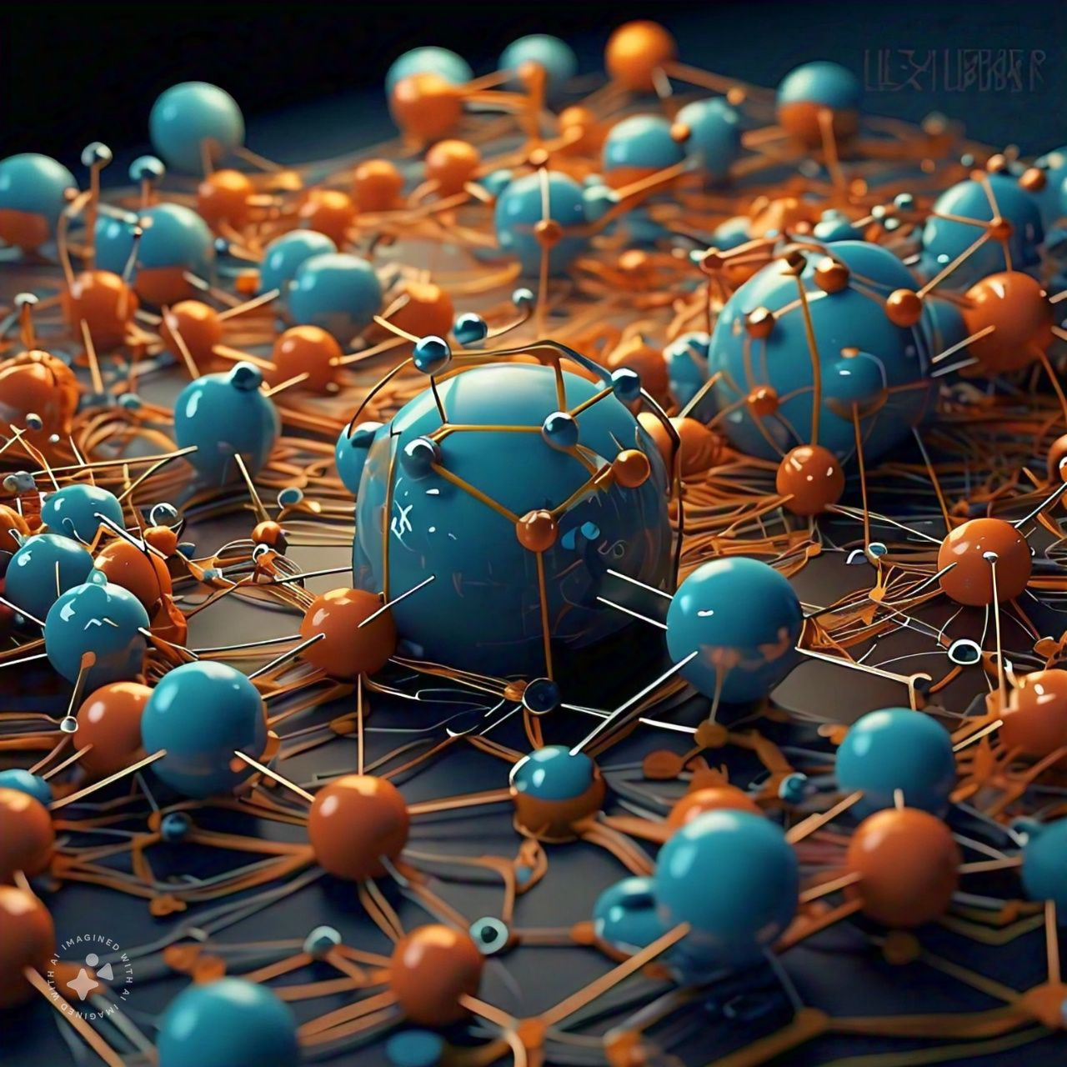
MEAN SHIFT

Slide 3
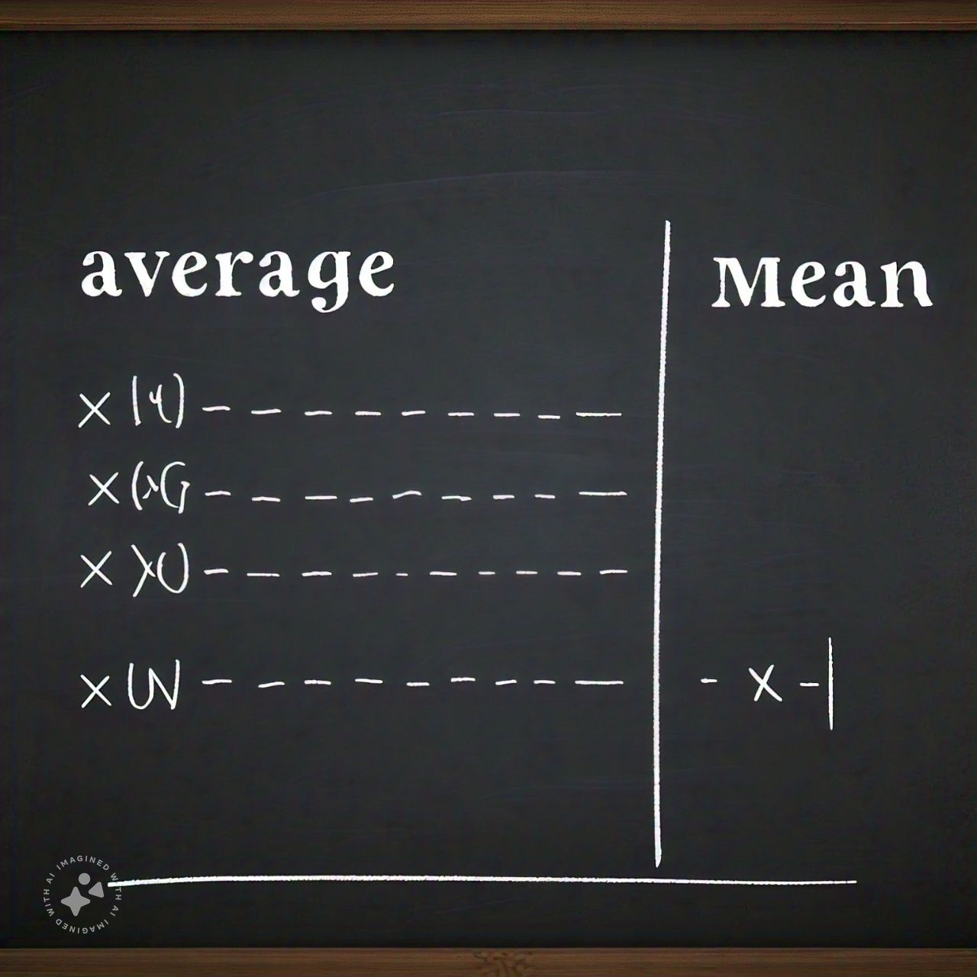

MEAN SHIFT

Slide 4
MEAN SHIFT
it is an example of a centroid based model, that works on updating the candidates for centroid
To be the center of the points within a given region.

Slide 5
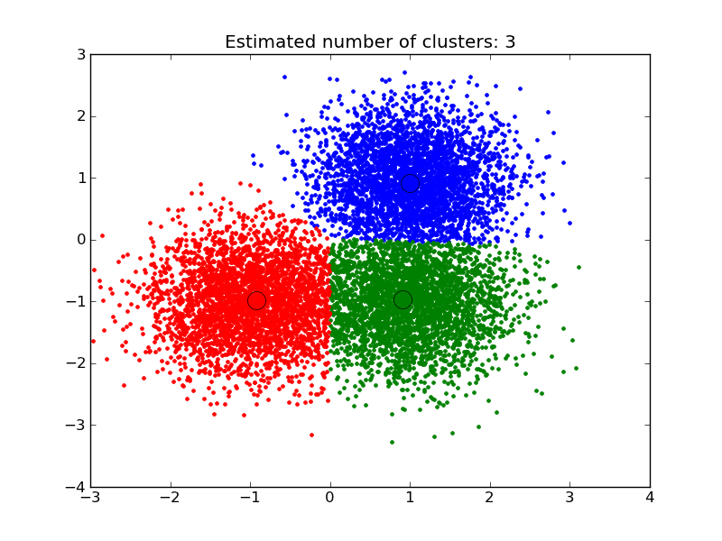
MEAN SHIFT

Slide 6
MEAN SHIFT

